Slide 1
K8s and F5 BIG-IP LTM Integration – Lab Guide
Chapter 4

Slide 2
Lab Architecture
Management (10.1.1.0/24)
10.1.1.8
10.1.1.4
Client
F5 BIG-IP
LTM VE
K8s Master
External (10.1.10.0/24)
Internal (10.1.20.0/24)
10.1.10.8
10.1.10.4
10.1.20.4
10.1.20.5
10.1.1.5
K8s Worker1
10.1.20.6
10.1.1.6
K8s Worker2
10.1.20.7
10.1.1.7

Slide 3
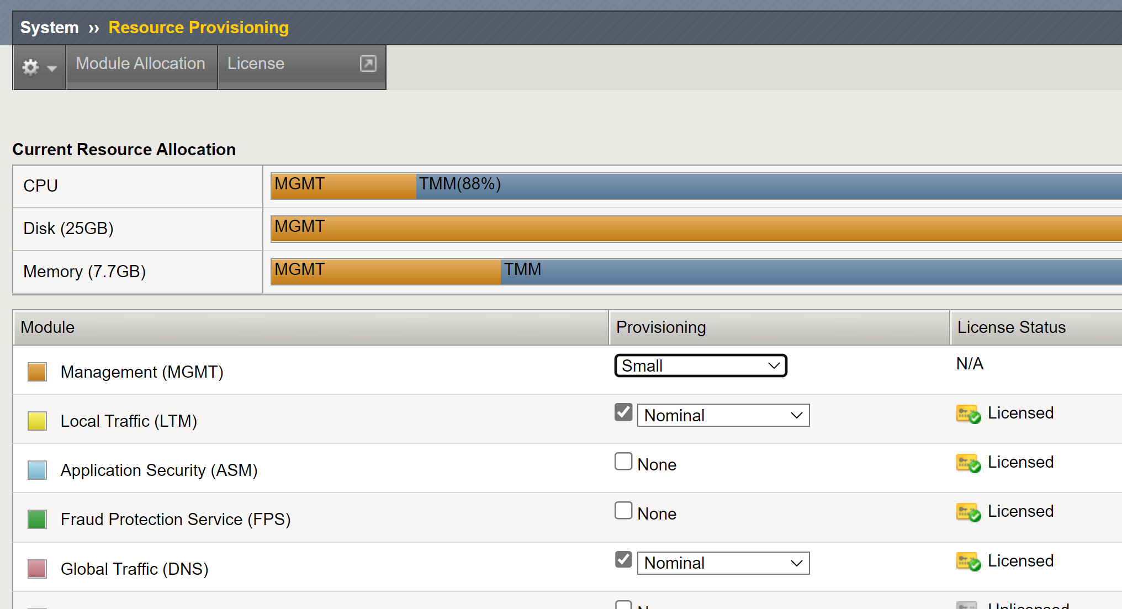
F5 BIG-IP Requirements
Basic BIG-IP configuration up to LTM and DNS/GTM provisioned.

Slide 4
F5 BIG-IP VE Requirements
Basic BIG-IP networking configured (VLAN and Self-IP).
Allow Service none (except with VXLAN for ClusterIP mode).

Slide 5
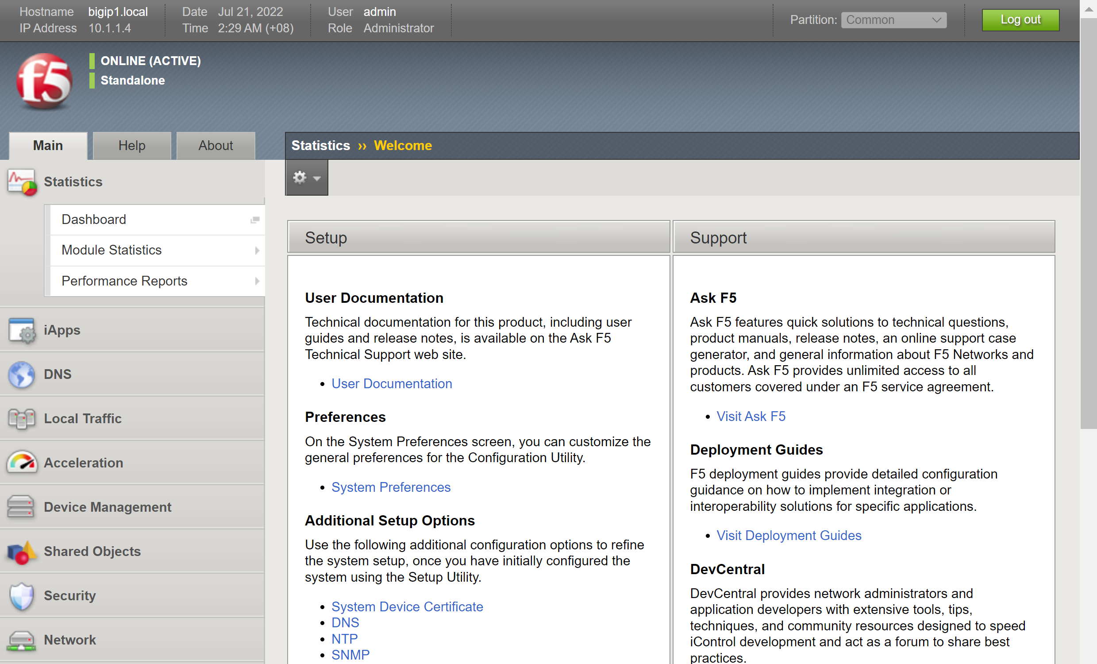
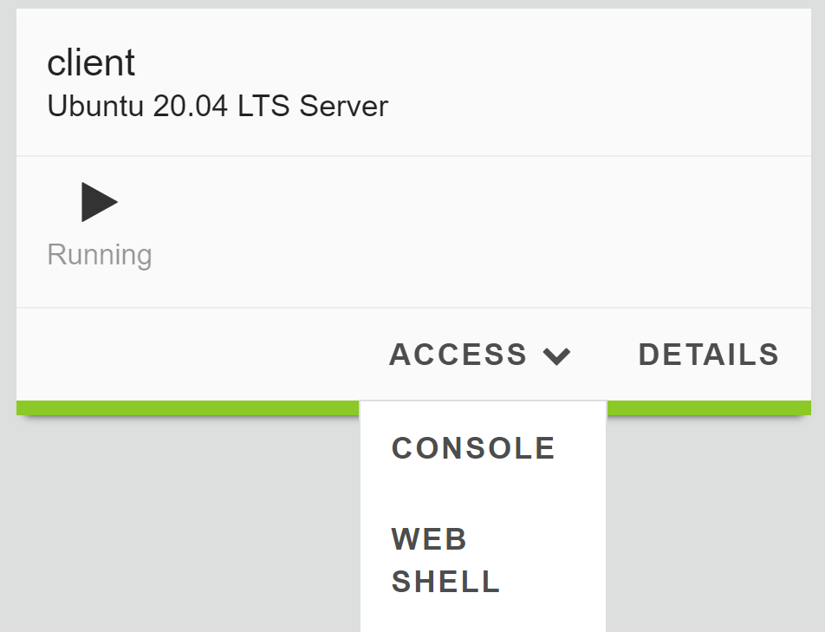
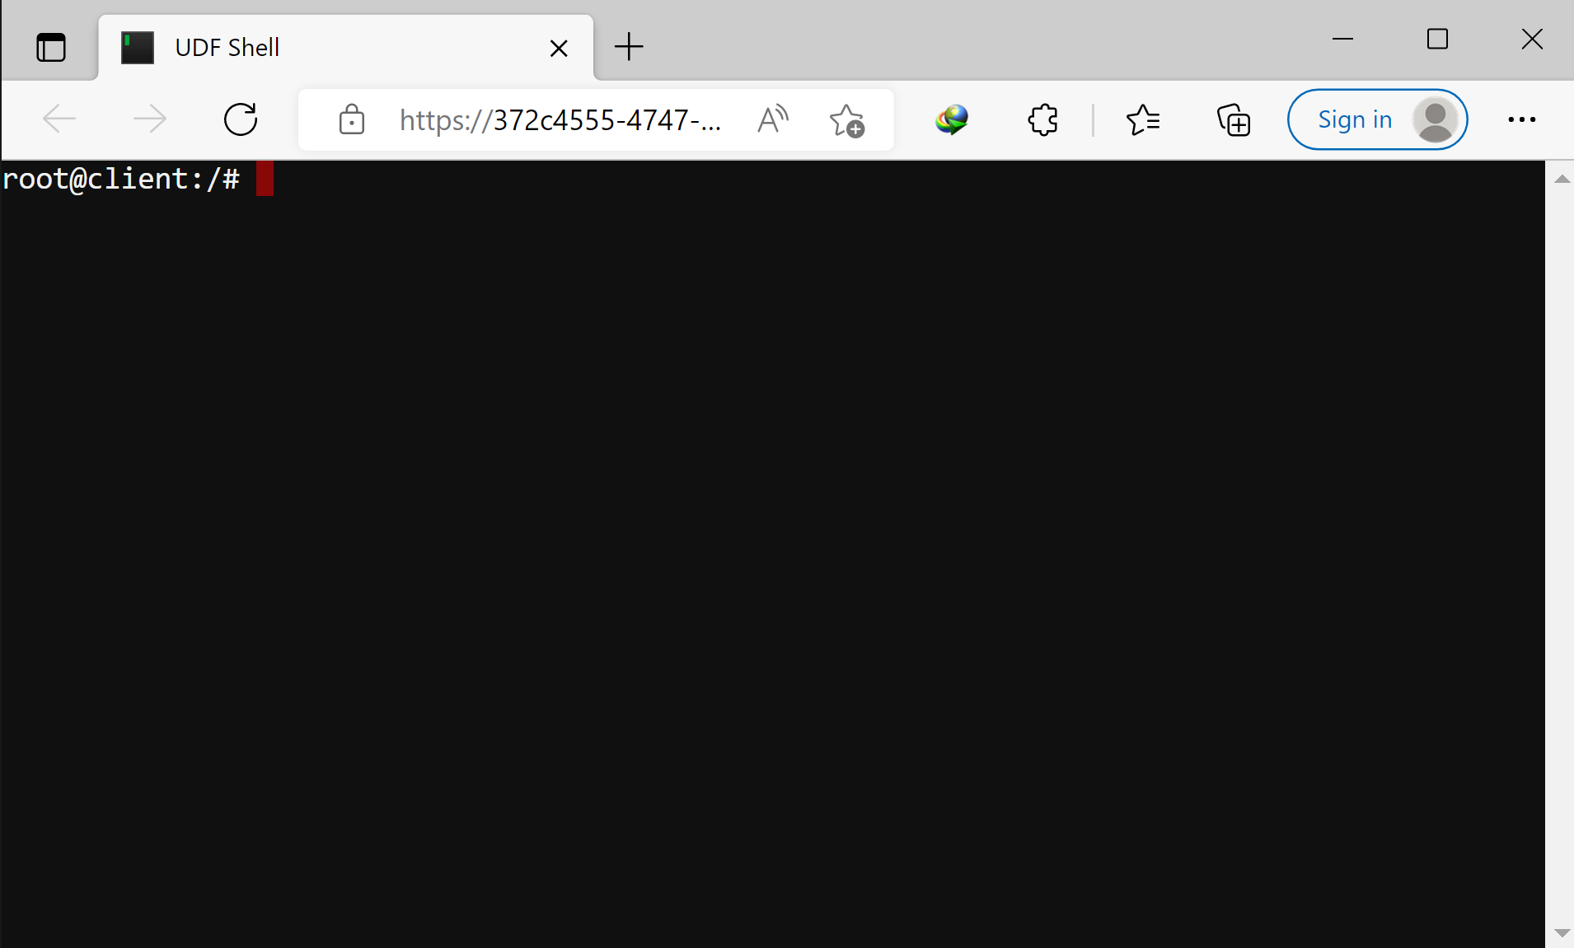
Access Preparation
At minimum, open the following access:
1) F5 GUI 2) Client CLI

Slide 6
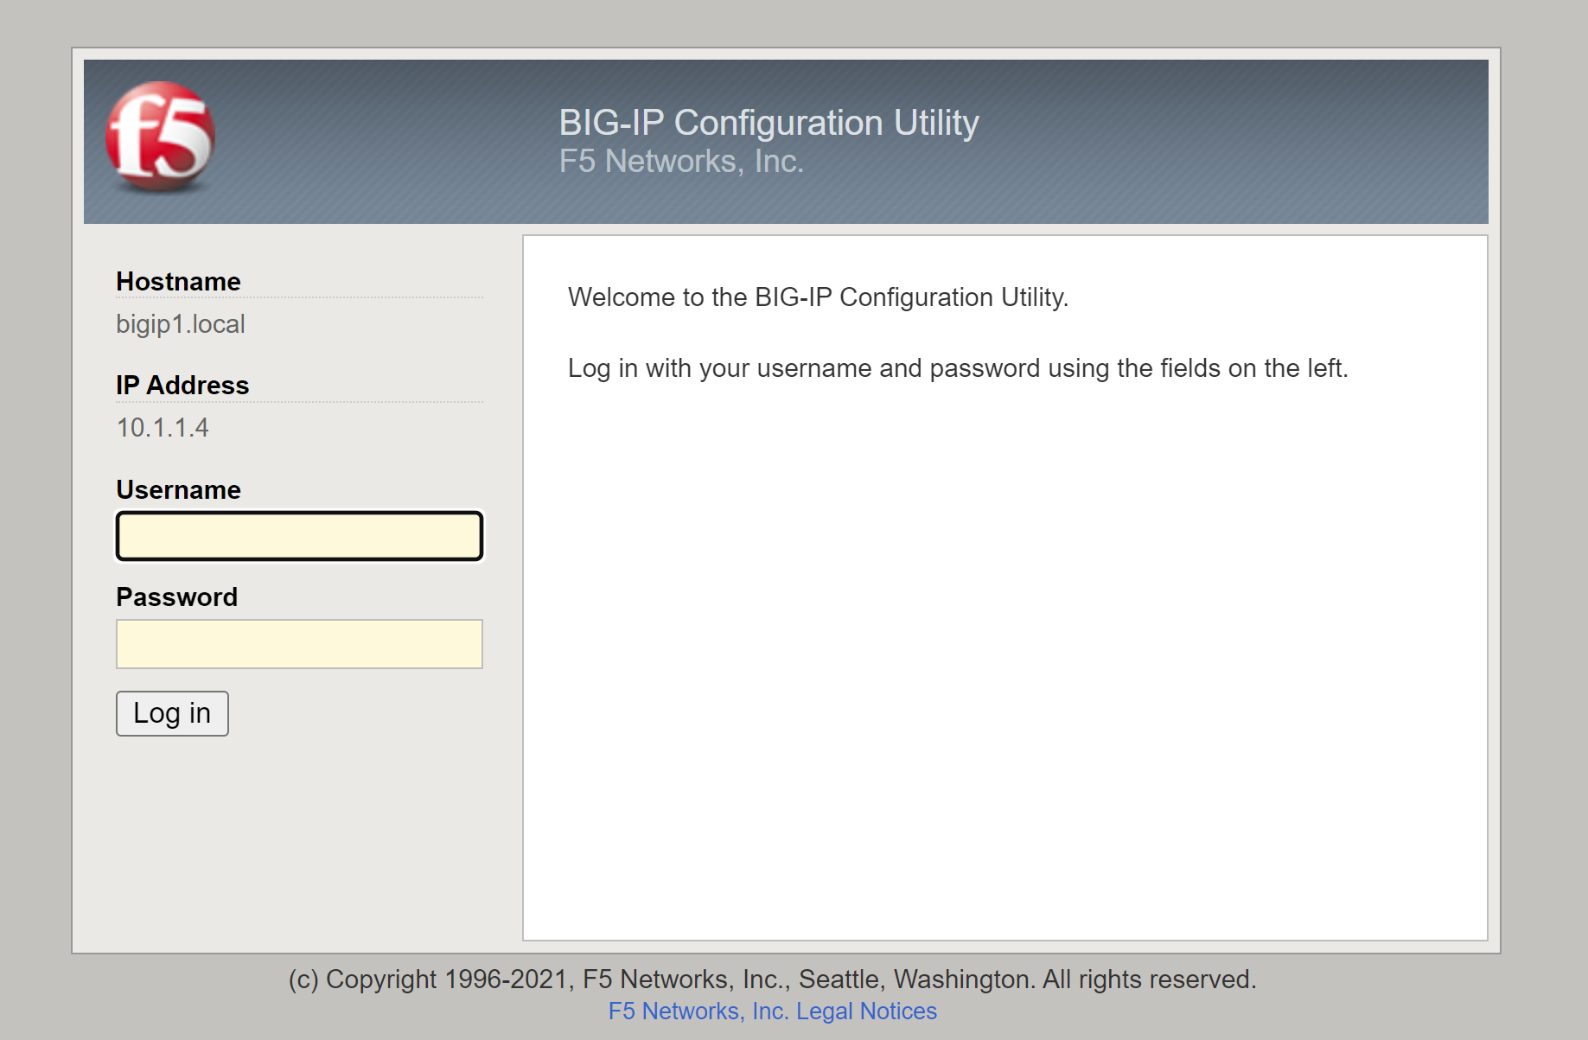
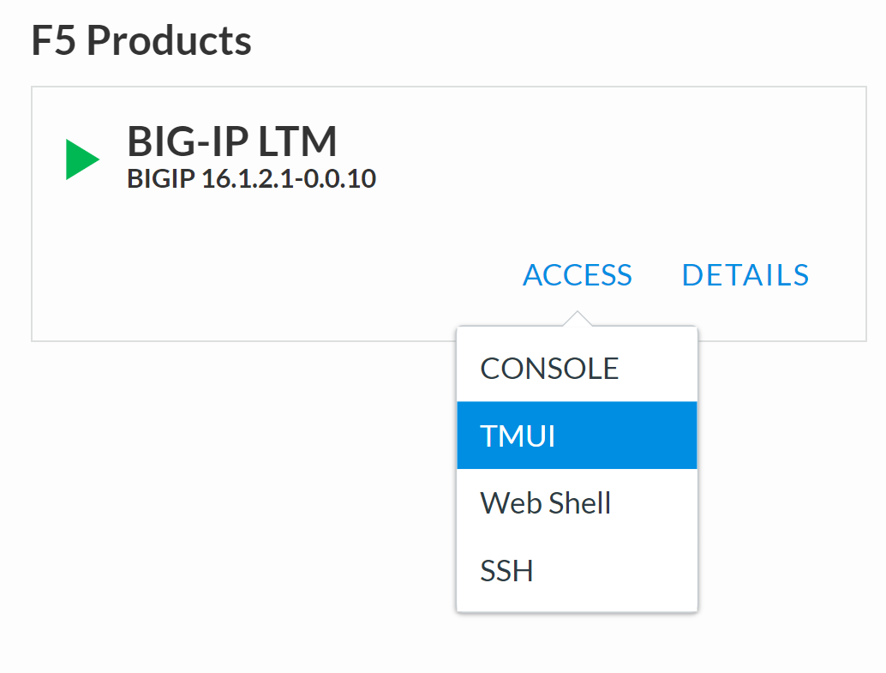
How to Connect to the Lab – F5 GUI
Username: admin
Password: admin
For GUI access

Slide 7
Copy+Paste From PPTX to Web Browser
The commands for the lab is provided in this PPTX. One example:
su - ubuntu

Slide 8
Copy+Paste From PPTX to Web Browser
The commands for the lab is provided in this PPTX. One example:
su - ubuntu
Select and Copy the above command line and Paste the command to the web shell.
You may also type the command directly to the web shell.
Shortcut Key Tips:
MS Edge – Paste: Ctrl + Shift + V
Google Chrome – Paste: Ctrl + V

Slide 9
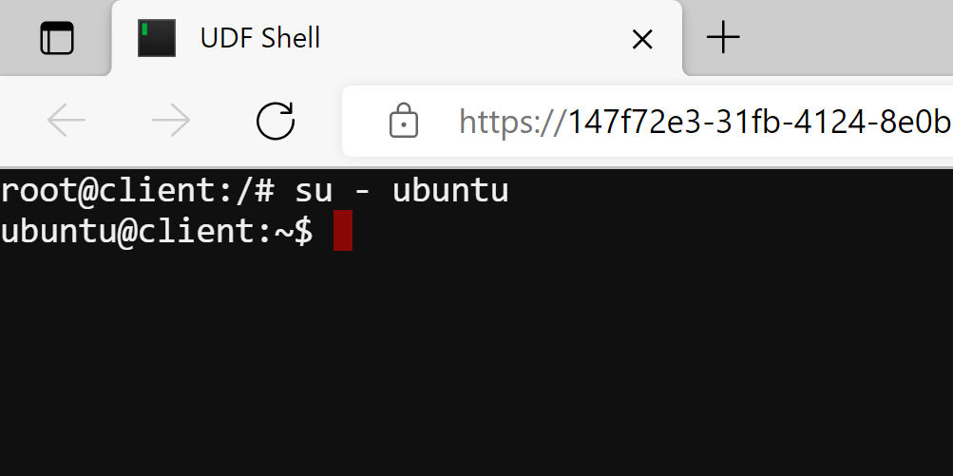
Ensure You Use "ubuntu" Account
Run the following command to login to "ubuntu" account from the web shell.
su - ubuntu
You should see "ubuntu@client:~$" prompt ➔
Note: It is a security practice to use normal privilege user account. Only use the privilege elevated user account when it is really needed.

Slide 10
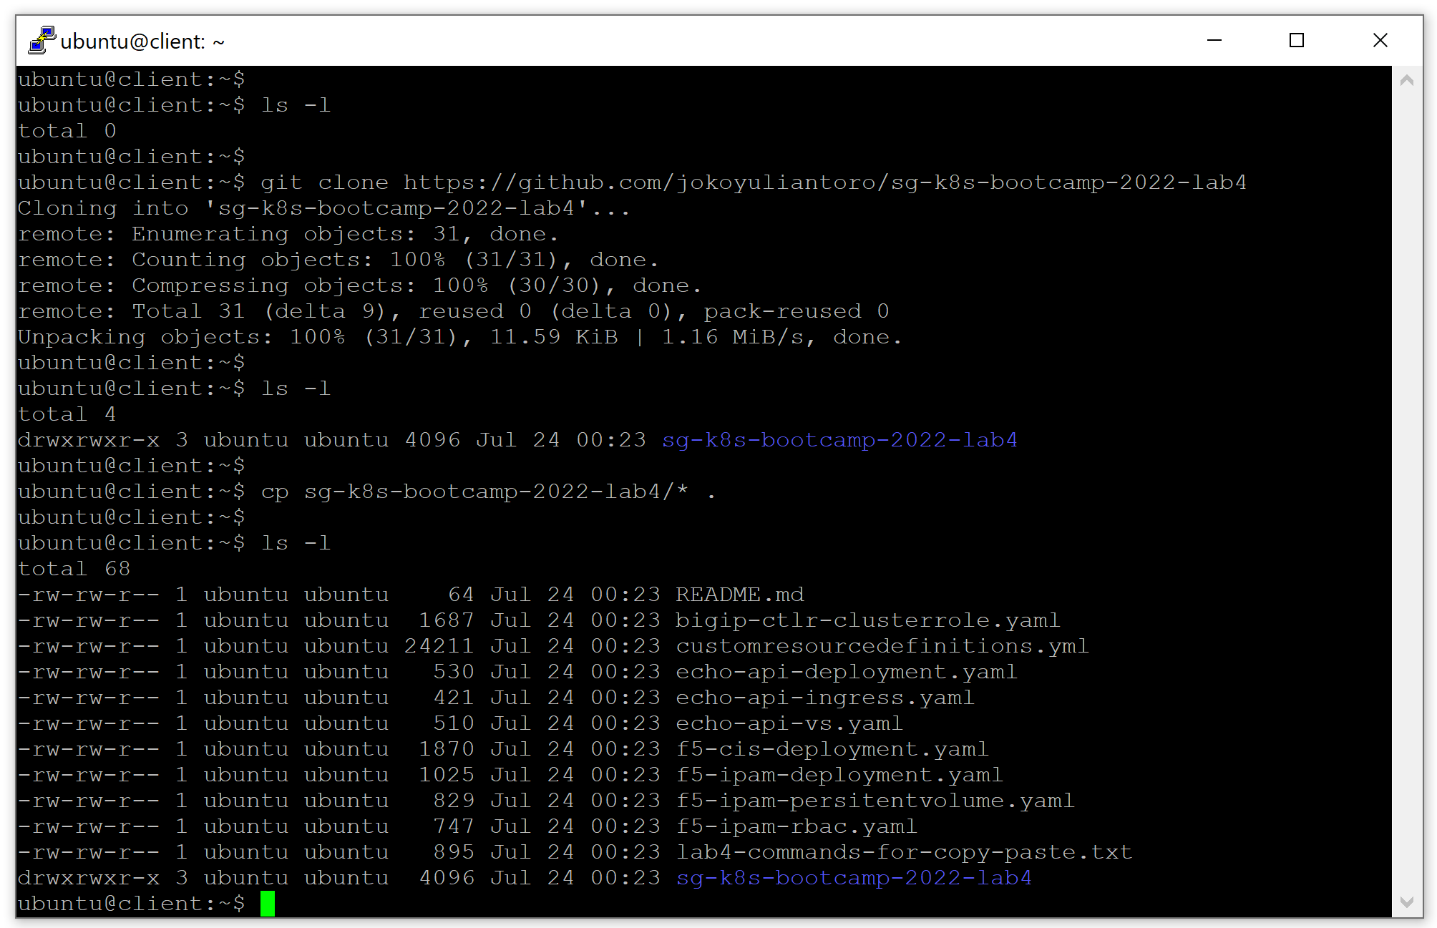
Download YAML Files to Local
Use "git clone" to download the YAML files to local storage inside the client VM and copy all cloned YAML files to the home directory.
git clone https://github.com/jokoyuliantoro/sg-k8s-bootcamp-2022-lab4
cp sg-k8s-bootcamp-2022-lab4/* .

Slide 11
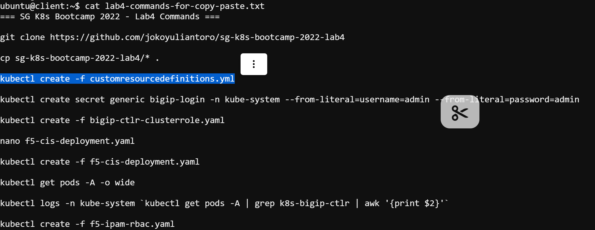
Alternative: Command List in TXT
A command list in TXT format is also available from the cloned GitHub repo.
The command list for this lab is lab4-commands-for-copy-paste.txt
You can use "cat", "more", "less", "cat", "head" or "tail" command to read the TXT file. Then you can Copy+Paste from and to the same web shell.

Slide 12
Lab 4 – CIS NodePort

Slide 13
Lab 4 – CIS NodePort
Lab Tasks
4.1) Confirm AS3 Installation in BIG-IP
4.2) F5 CIS Installation in K8s
4.3) F5 IPAM Installation in K8s
4.4) Create a deployment in K8s
4.5) Send test traffic and inspect it

Slide 14
Task 4.1) Confirm AS3 Installation in BIG-IP

Slide 15
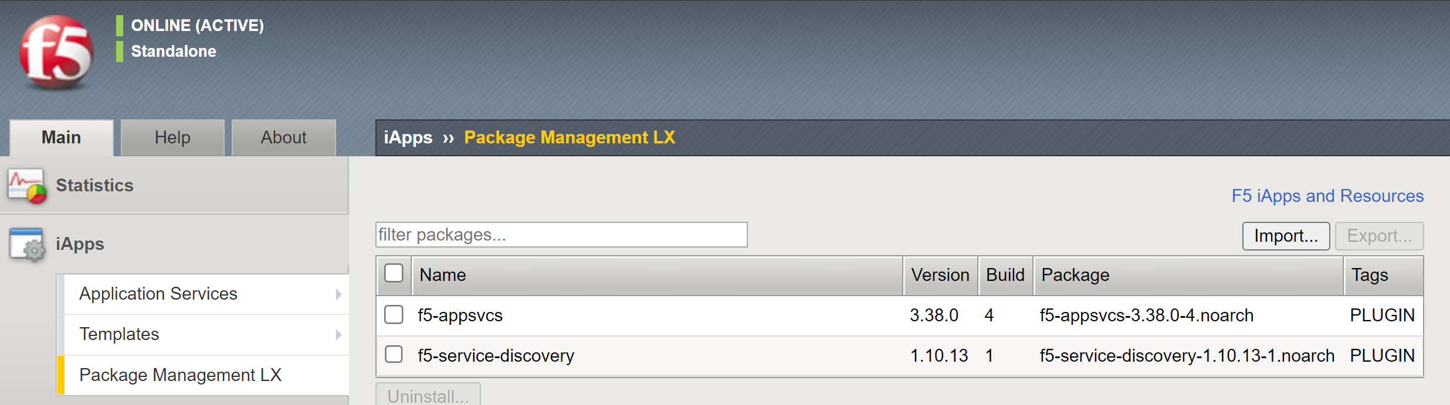
Task 4.1) Confirm AS3 Installation in BIG-IP
Bring up the F5 GUI and follow the steps below:
1
2

Slide 16
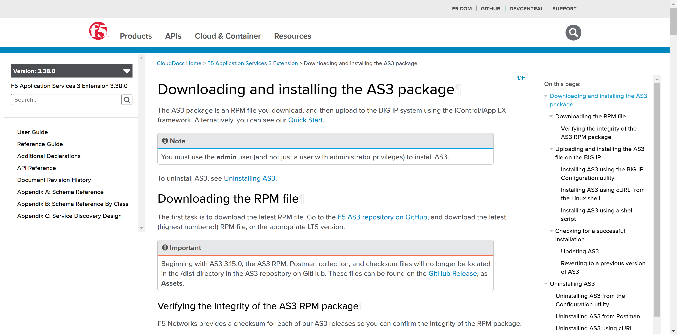
Task 4.1) Confirm AS3 Installation in BIG-IP
If the AS3 is not yet installed, you can installed it by following the installation guide: https://clouddocs.f5.com/products/extensions/f5-appsvcs-extension/latest/userguide/installation.html

Slide 17
Task 4.2) F5 CIS Installation in K8s

Slide 18
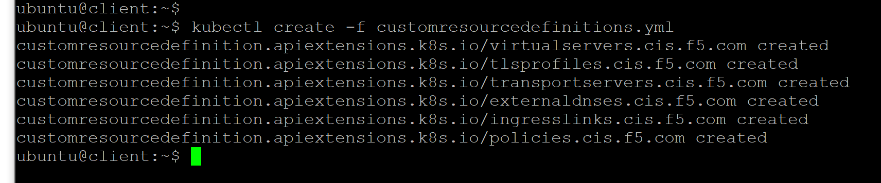
Task 4.2) F5 CIS Installation in K8s
Installing F5 CIS starts with installing the CRD to K8s cluster:
kubectl create -f customresourcedefinitions.yml
Note: You can download the original CRD from the CIS Github to the Master node: https://raw.githubusercontent.com/F5Networks/k8s-bigip-ctlr/master/docs/config_examples/customResourceDefinitions/customresourcedefinitions.yml

Slide 19
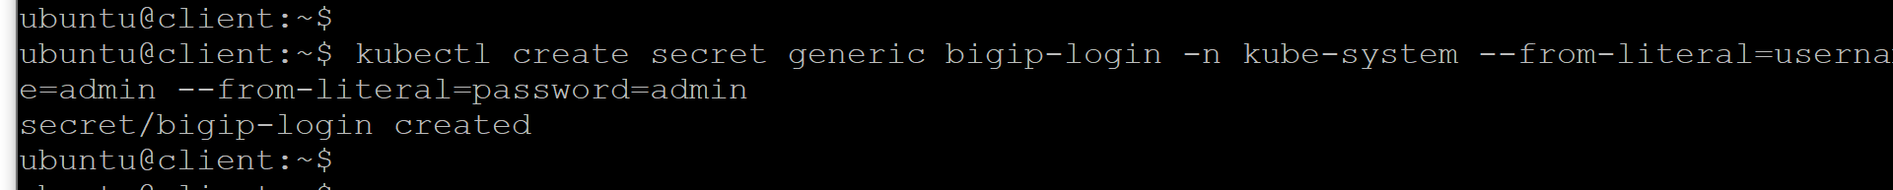
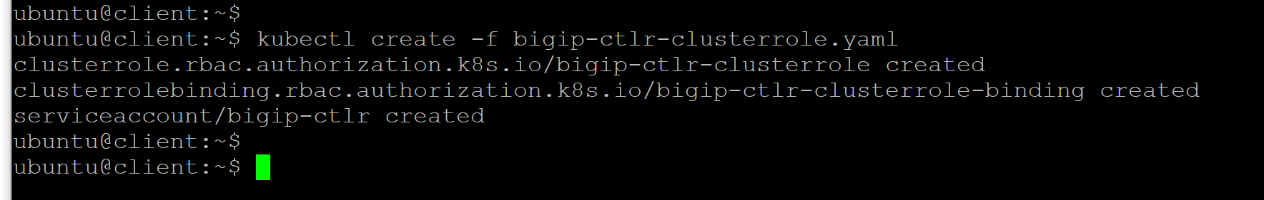
Task 4.2) F5 CIS Installation in K8s
Create the secret containing the admin's username and password of the F5 device.
kubectl create secret generic bigip-login -n kube-system --from-literal=username=admin --from-literal=password=admin
Create the cluster role, the cluster role binding, and the service account.
kubectl create -f bigip-ctlr-clusterrole.yaml

Slide 20
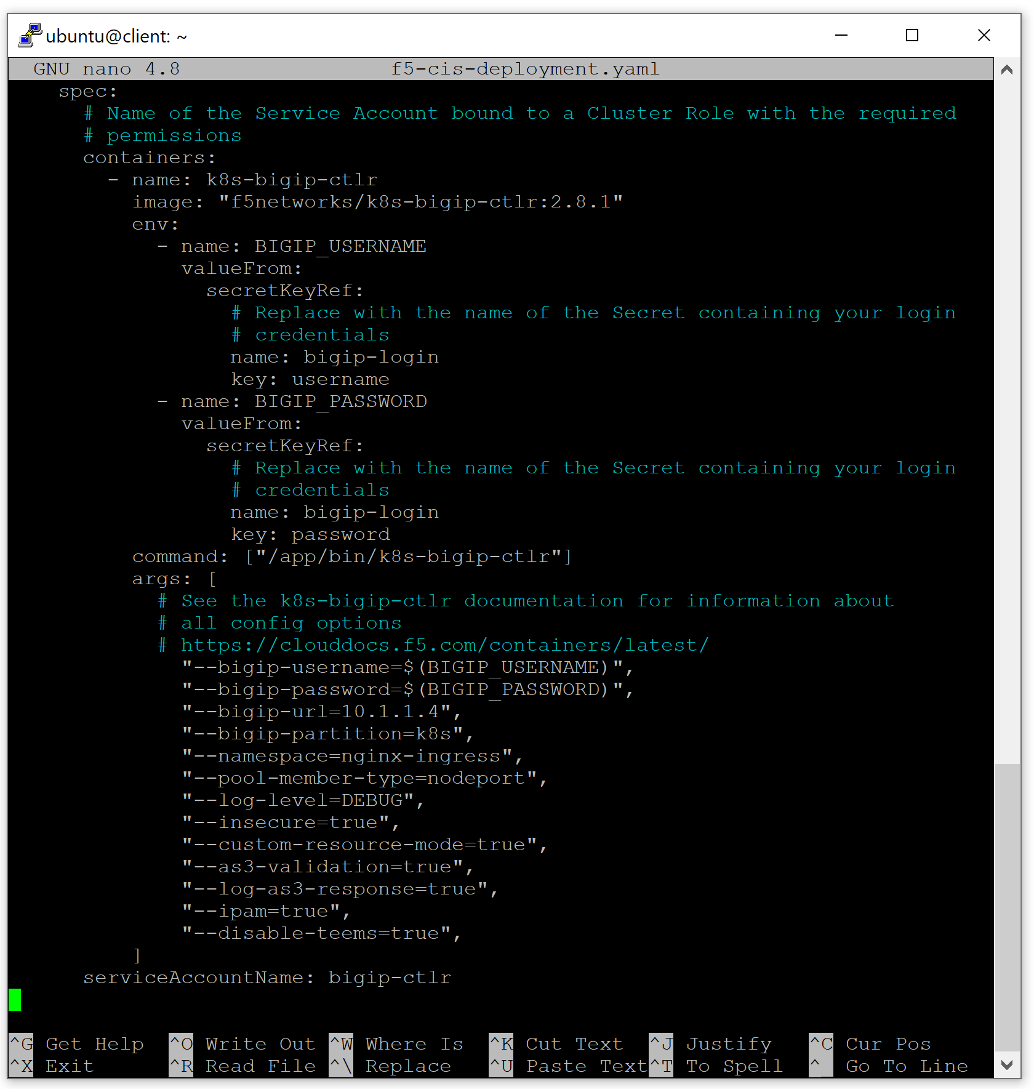
Task 4.2) F5 CIS Installation in K8s
Examine the CIS deployment setting.
nano f5-cis-deployment.yaml
Once done, exit the editor by Ctrl-X.

Slide 21
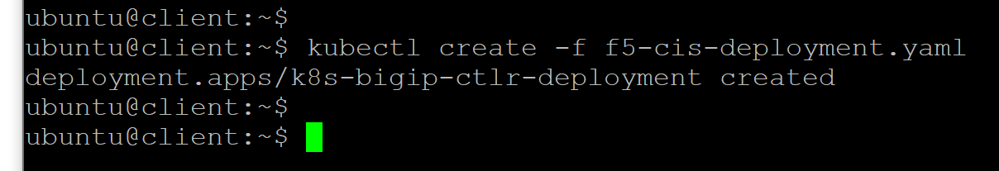
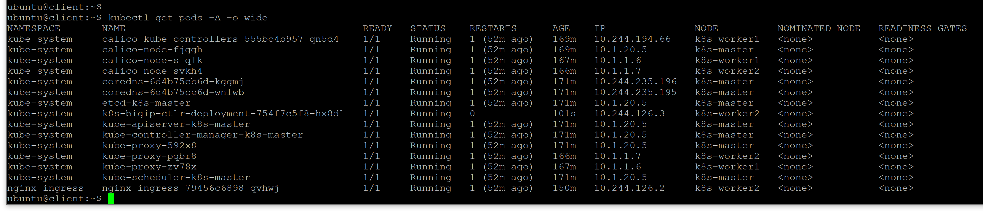
Task 4.2) F5 CIS Installation in K8s
Install the F5 CIS.
kubectl create -f f5-cis-deployment.yaml
Check the CIS installation result
kubectl get pods -A -o wide

Slide 22
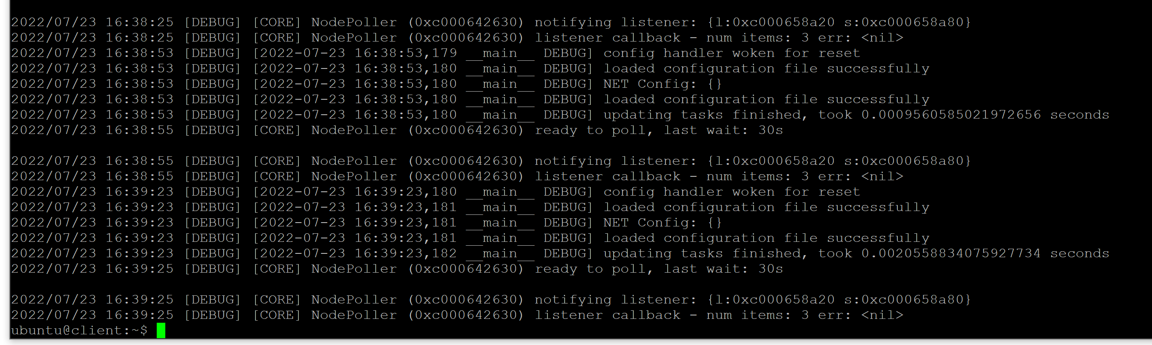

Task 4.2) F5 CIS Installation in K8s
Check the F5 CIS logs.
kubectl logs -n kube-system `kubectl get pods -A | grep k8s-bigip-ctlr | awk '{print $2}'`

Slide 23
Task 4.3) F5 IPAM Installation in K8s

Slide 24
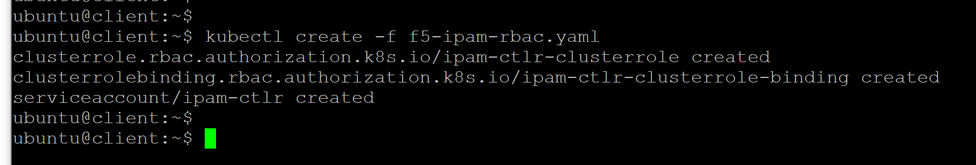
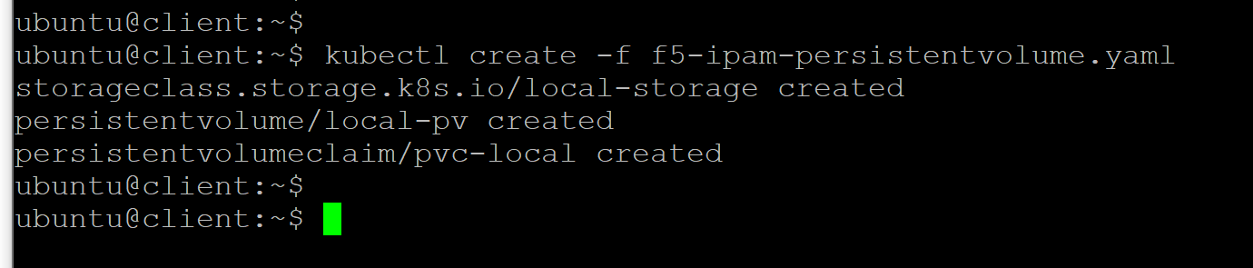
Task 4.3) F5 IPAM Installation in K8s
Installing the F5 IPAM in Kubernetes cluster starts with creating the cluster role, the cluster role binding, and the service account.
kubectl create -f f5-ipam-rbac.yaml
Create persistent volume to store F5 IPAM data.
kubectl create -f f5-ipam-persistentvolume.yaml

Slide 25
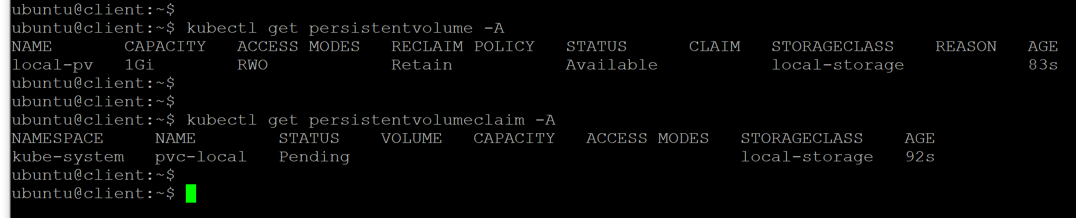
Task 4.3) F5 IPAM Installation in K8s
Confirm that the persistent volume has been correctly created.
kubectl get persistentvolume -A
kubectl get persistentvolumeclaim -A

Slide 26
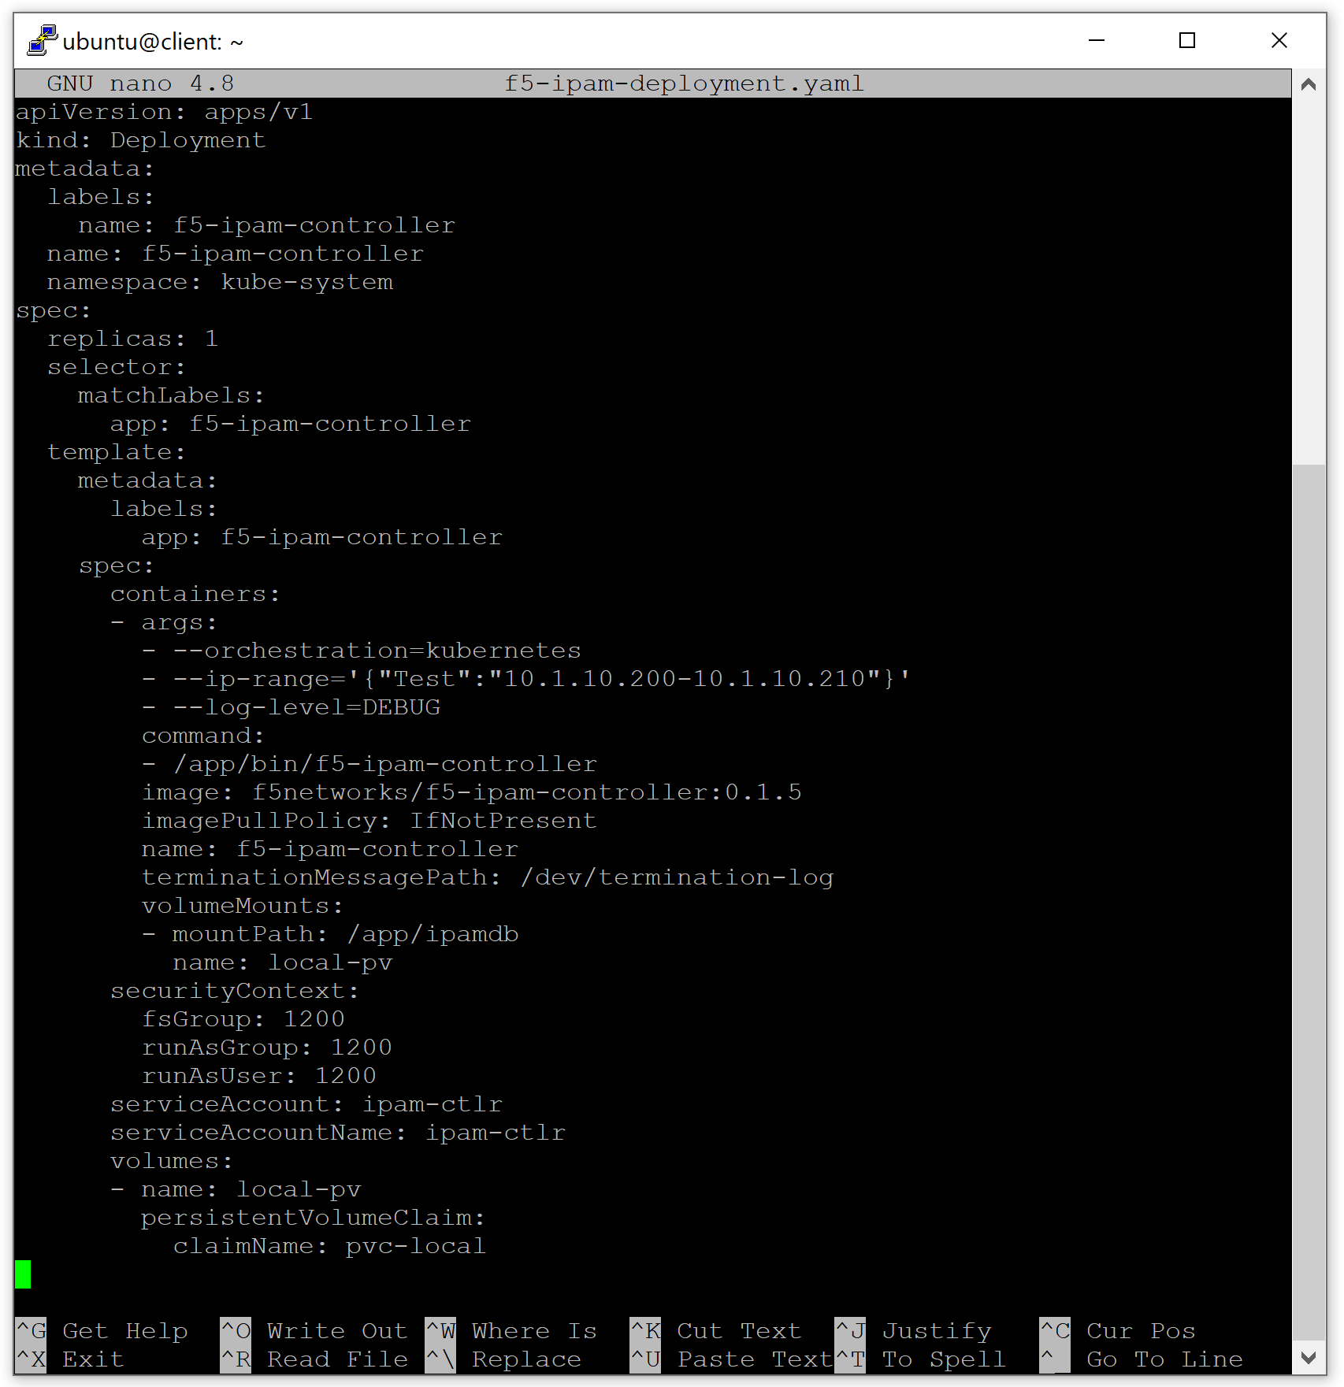
Task 4.3) F5 IPAM Installation in K8s
Examine the F5 IPAM deployment setting.
nano f5-ipam-deployment.yaml
Once done, exit the editor by Ctrl-X.

Slide 27
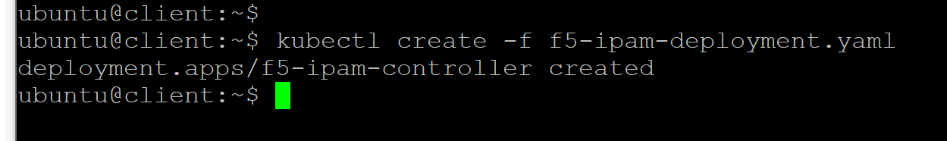
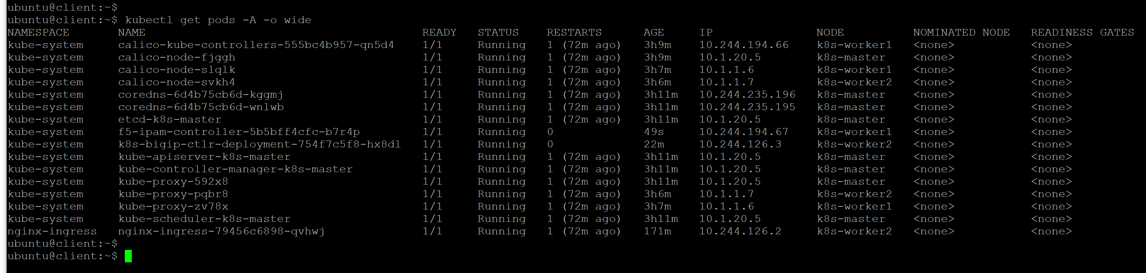
Task 4.3) F5 IPAM Installation in K8s
Install the F5 IPAM.
kubectl create -f f5-ipam-deployment.yaml
Check the IPAM installation result
kubectl get pods -A -o wide

Slide 28
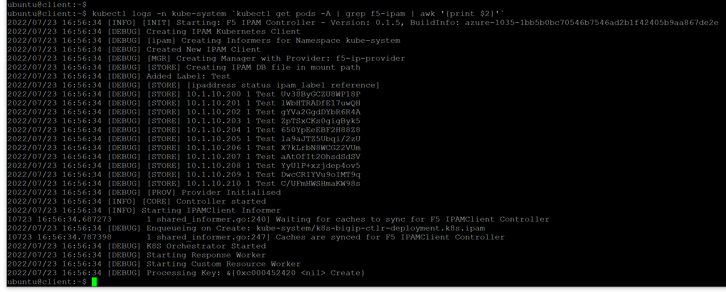
Task 4.3) F5 IPAM Installation in K8s – change capture
Check the F5 CIS logs.
kubectl logs -n kube-system `kubectl get pods -A | grep f5-ipam | awk '{print $2}'`

Slide 29
Task 4.4) Create a Deployment in K8s

Slide 30
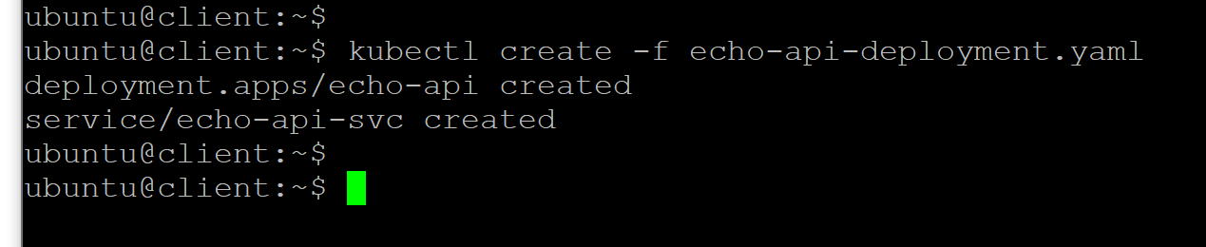
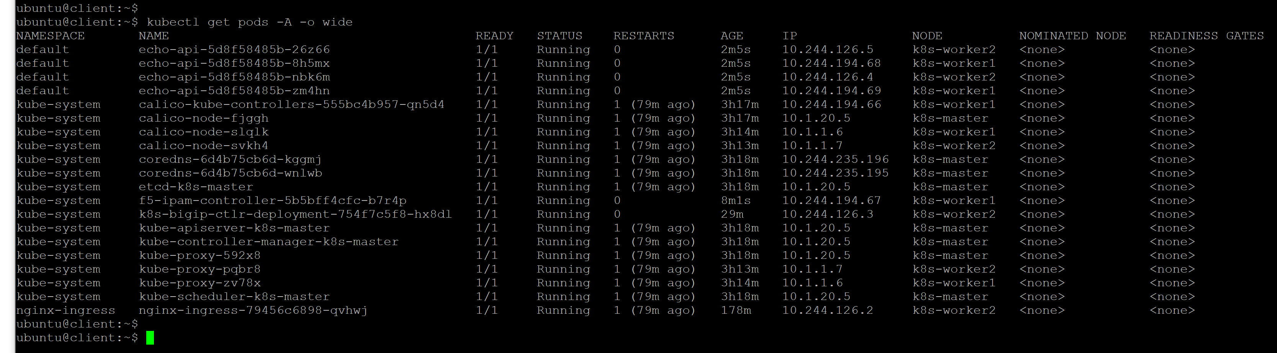
Task 4.4) Create a Deployment in K8s
Deploy a JSON-based Echo Server.
kubectl create -f echo-api-deployment.yaml
kubectl get pods -A -o wide

Slide 31
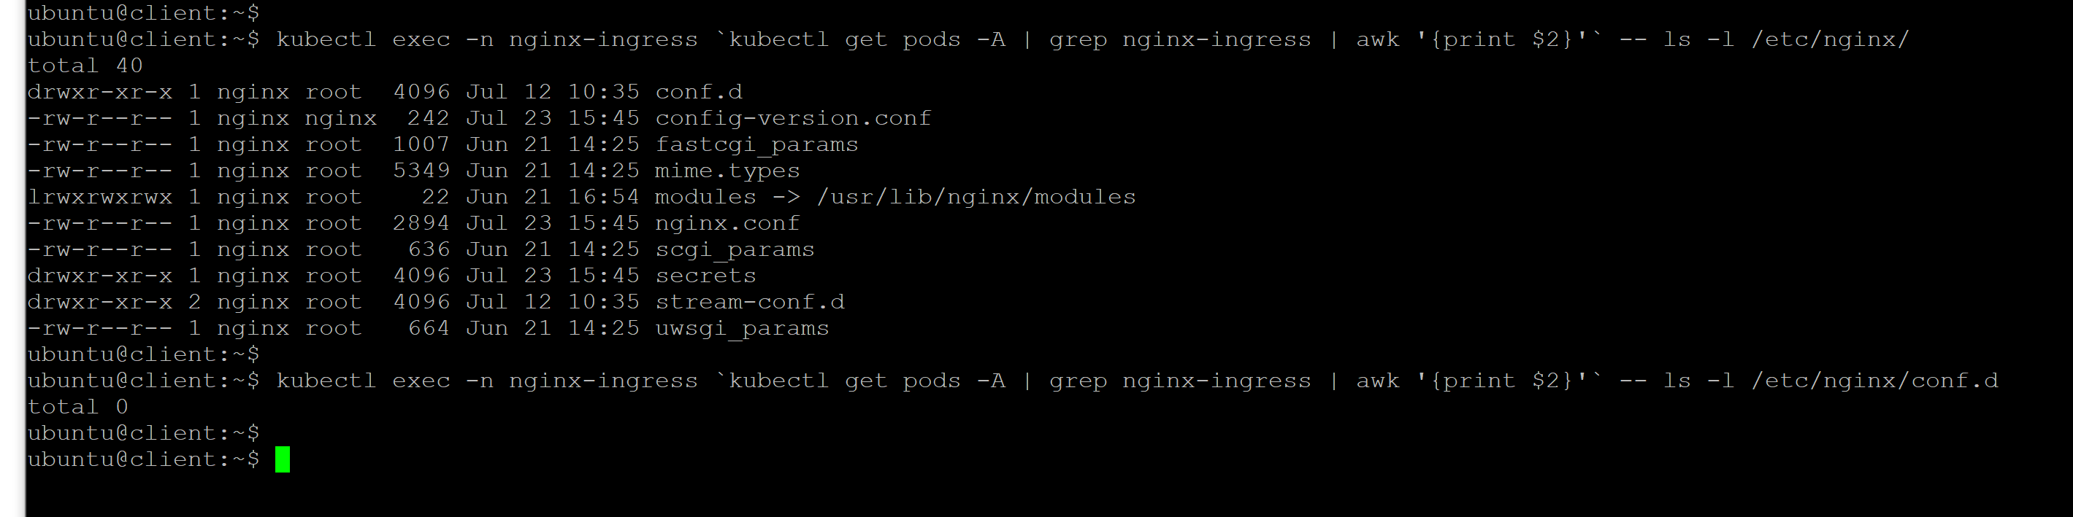
Task 4.4) Create a Deployment in K8s
Before creating the Ingress for the Echo Server, let's see the settings in the NGINX IC.
kubectl exec -n nginx-ingress `kubectl get pods -A | grep nginx-ingress | awk '{print $2}'` -- ls -l /etc/nginx/
kubectl exec -n nginx-ingress `kubectl get pods -A | grep nginx-ingress | awk '{print $2}'` -- ls -l /etc/nginx/conf.d

Slide 32
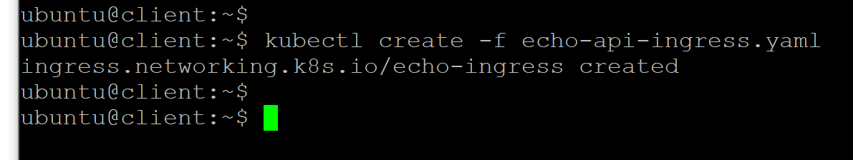
Task 4.4) Create a Deployment in K8s
Create the Ingress for Echo Server.
kubectl create -f echo-api-ingress.yaml
Once the Ingress is created, NGINX IC automatically creates the corresponding configuration.
kubectl exec -n nginx-ingress `kubectl get pods -A | grep nginx-ingress | awk '{print $2}'` -- ls -l /etc/nginx/conf.d

Slide 33
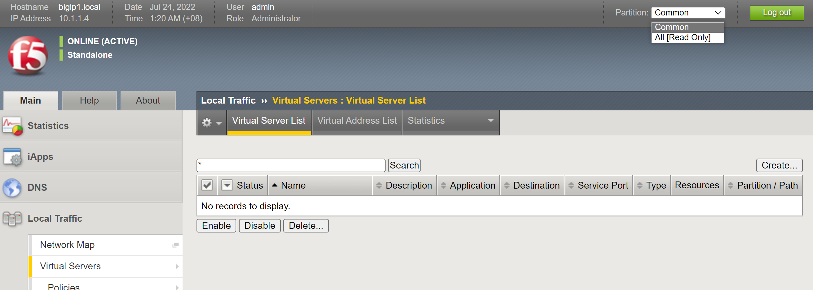
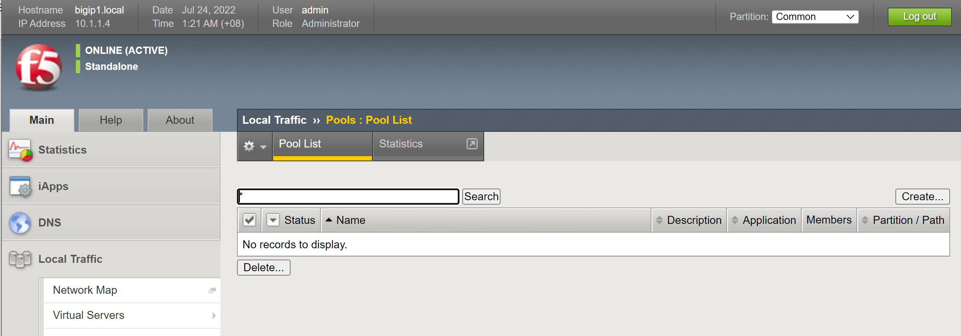
Task 4.4) Create a Deployment in K8s
The next step is to create VirtualServer CRD for the Echo Server which will trigger a new configuration creation in F5 BIG-IP. Before that event, let's inspect the F5 configuration using F5 GUI.
Virtual Server List is Empty
Partition List contains only Common
Pool List is Empty

Slide 34
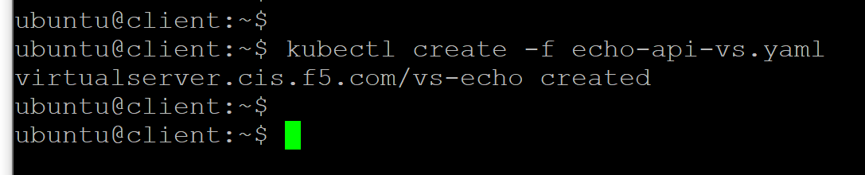
Task 4.4) Create a Deployment in K8s
Create the VirtualServer CRD for Echo Server.
kubectl create -f echo-api-vs.yaml

Slide 35
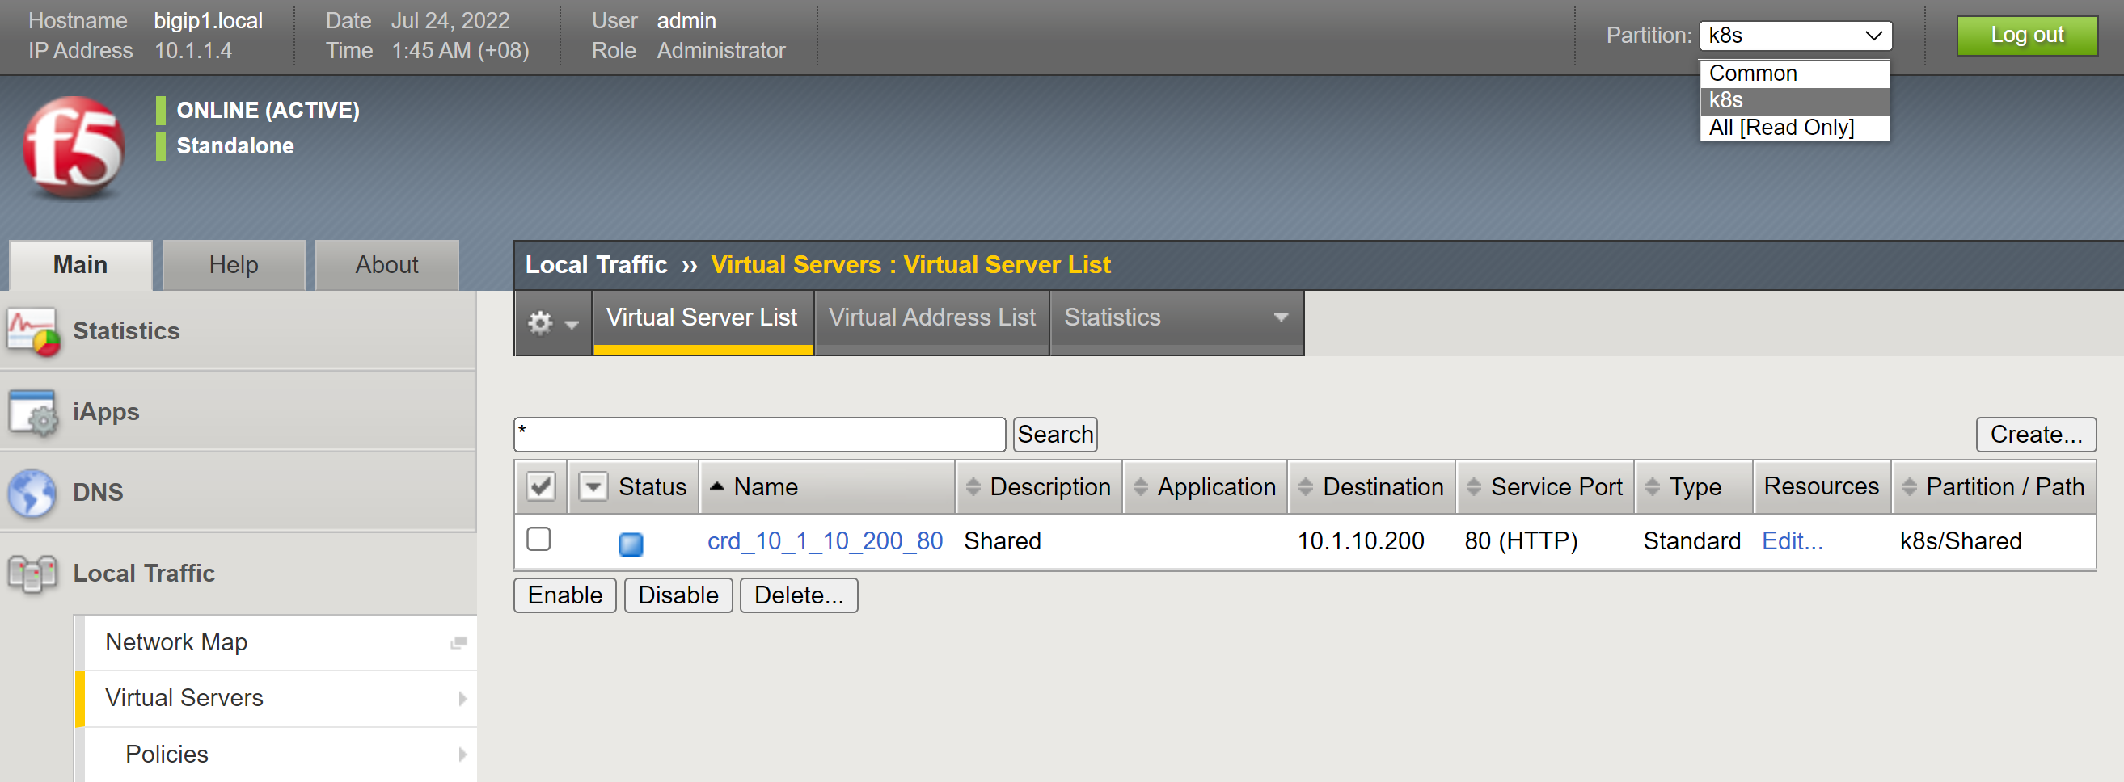
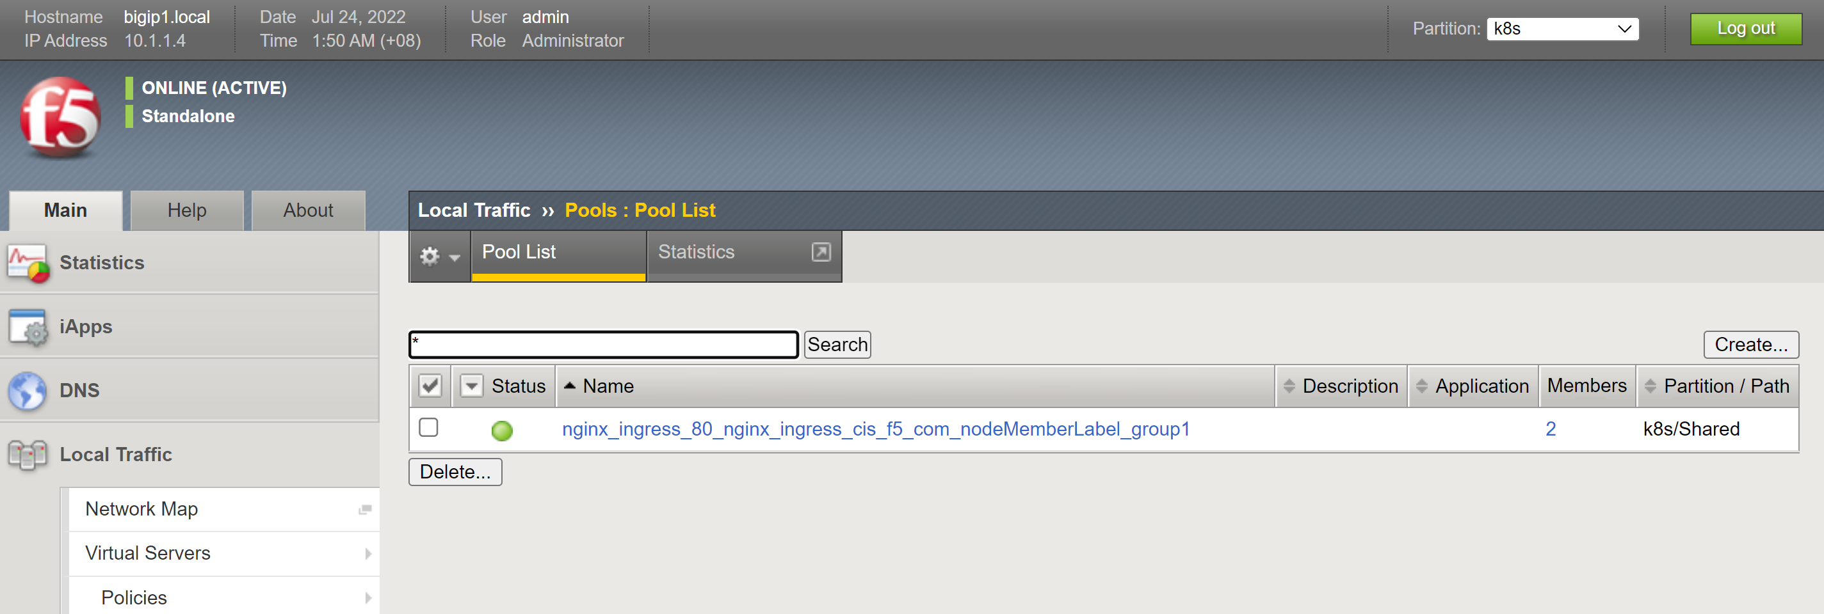
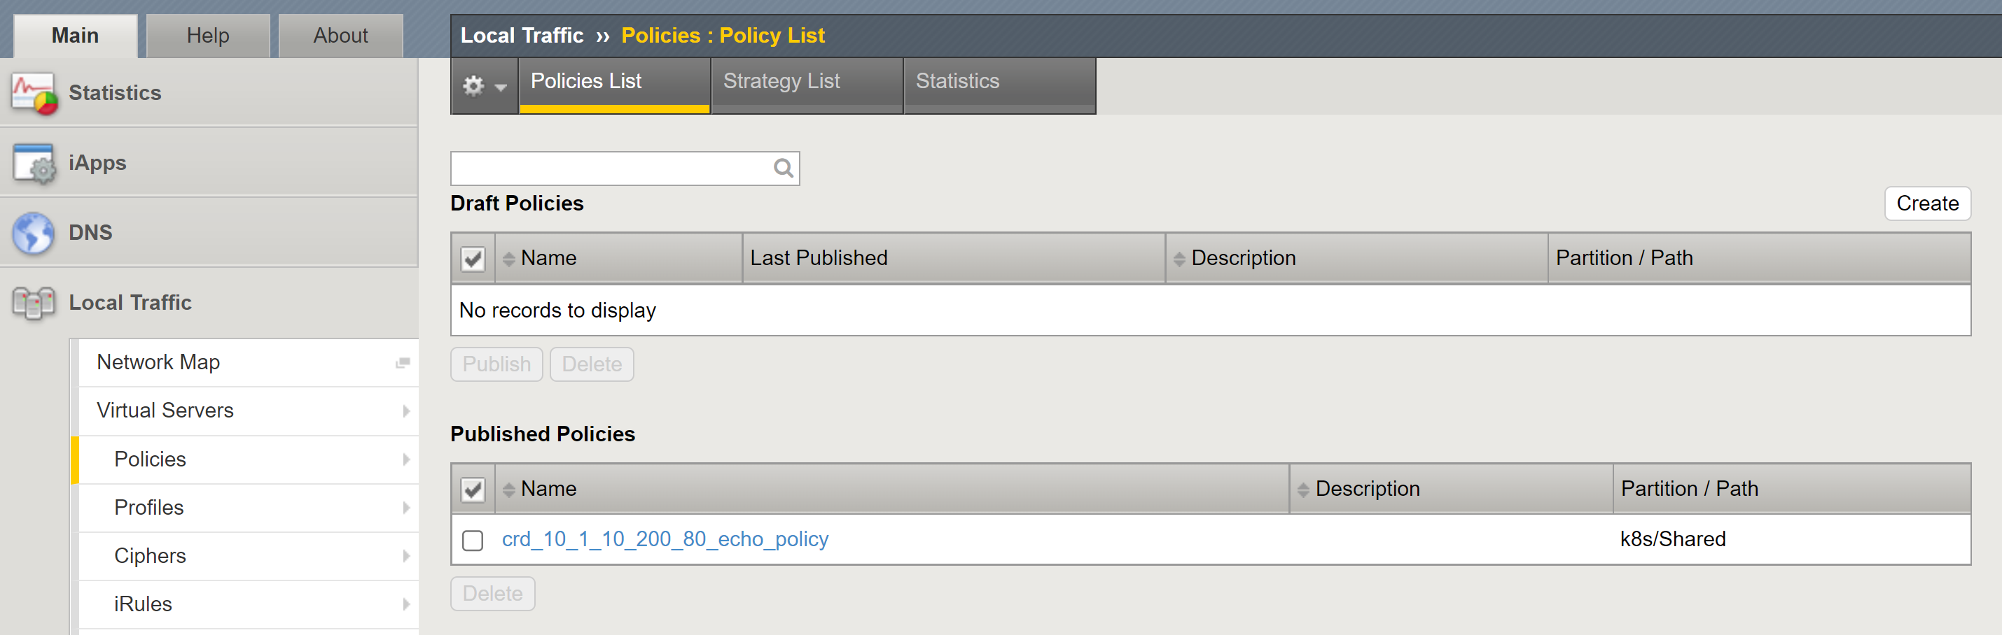
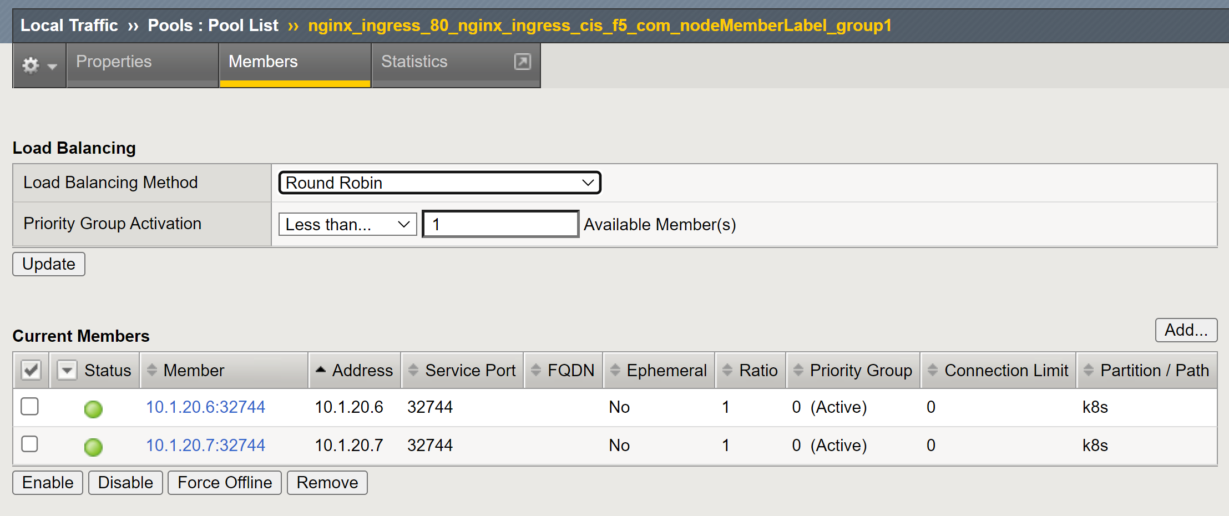
Task 4.4) Create a Deployment in K8s
Once the VirtualServer CRD is created in the K8s clutser, CIS creates the virtual servers, the pools, the nodes, the traffic policy, etc in F5 device.

Slide 36
Task 4.5) Send Test Traffic and Inspect It

Slide 37
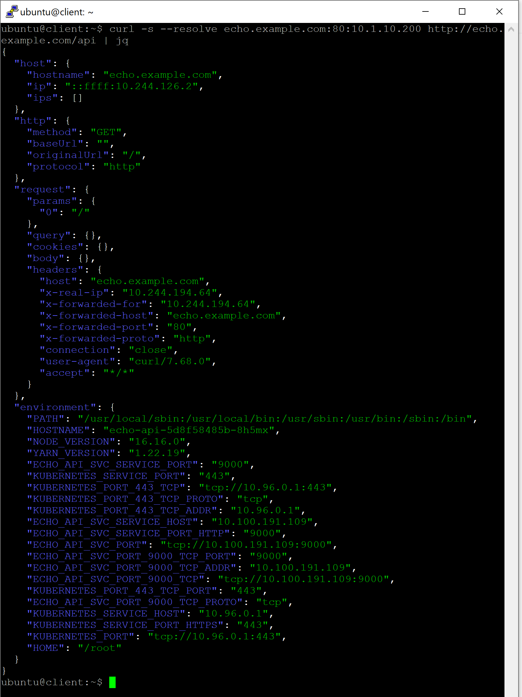
Task 4.5) Send Test Traffic and Inspect It
Send several test traffic by repeating the following command.
curl -s --resolve echo.example.com:80:10.1.10.200 http://echo.example.com/api | jq
Observe several important keys such as HOSTNAME, x-forwarded-for, ECHO_API_SVC_SERVICE_HOST, and ECHO_API_SVC_SERVICE_PORT.

Slide 38
Summary

Slide 39
What We Have Learned in This Chapter
Connect K8s pod properly to outside K8s network using an ADC (Application Delivery Controller) that has automation capability.
Deploy F5 CIS to automate the F5 BIG-IP LTM according to the pod lifecycle.
Inspect the traffic flow from client → F5 → K8s pod.

